Slide 1
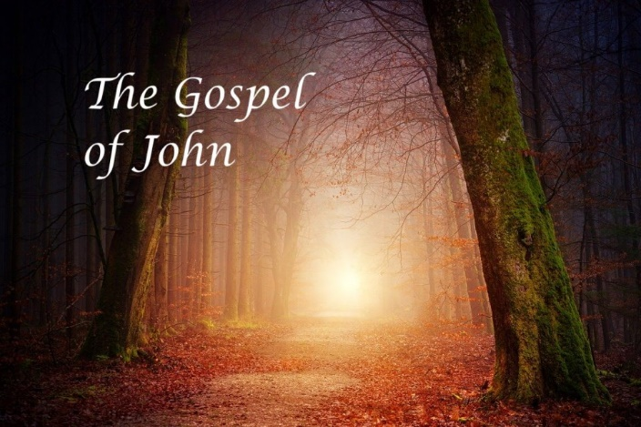

The Gospel
of John
Short
Introduction
Part 1: Yahusha & the Jews’ Feast of Tabernacles
Why in the world is this chapter so important?
Do you know what John 7 is all about?
Notes:
Redo the John 7 series in Jan 2023:
5.9a John 7 Part 1 Teaser 7 min: Website:
You-tube launched 9 am Jan 30/23: ​ https://youtu.be/CP2_ZdIkf-s
Blurb 5.9a: John 7 context is about the Tabernacles Feast of the Jews – not the Feast of the Torah. Yahusha refused to go up to the feast with his brethren? Why? Was He not required to attend according to Torah Statutes? “Come and See” if the thought provoking questions in Part 1 will help you to ponder this chapter a little deeper. Shalom!
*************************** ALL OLD Files removed Dec 2022.
June 16/22 8 min: 5.6a Teaser for John 7 & Yahusha’s Contempt Pt 1 Intro [14 slides] TA 16 June 2022
https://www.youtube.com/watch?v=oPVL0QLba2M
https://youtu.be/oPVL0QLba2M
Website: https://studythecalendar.com/5-6-john-7-yahushas-contempt/
Launched 830 AM June 17th Views: 1st day 1163;
OLD Blurb: John is the favorite Gospel for many people for various reasons. Why is this? At Covenant Calendar Club, we know why John is a favorite Gospel for just about every calendar teaching. This is because John records details of many events that the synoptic Gospels are completely silent on. Even in the Covenant Calendar studies, John is very detailed so that his studious readers can tell exactly Who the true Messiah is, and exactly what set-apart appointed times He kept. This short introduction will prepare you for what is to come in Part 1 of John chapter 7. There are a lot of questions to be asked if Yahusha is following Torah, and if He isn’t, then would that be considered rebellion. Notice the very interesting clues that John gives for this extra-ordinary record of the unbelieving Jews’ Feast of Tabernacles. We’re quite sure you’ll want to “Come and See.” Shalom!

Slide 2

If ever, in your journey,
you have HEARD -
“Yahusha observed the Feasts of the Jews,”
and wondered if in fact it were true,
and desired Scriptural evidences,
then this study in John 7, will be of
GREAT INTEREST to you.
Will Yahusha’s actions speak
“louder than words” in John 7?

Slide 3

John Chapter 7 Starts Out Like This:
After these things Yahusha walked in Galilee: for he would not walk in Jewry, because the Jews sought to kill him.
Now the Jews' feast of tabernacles was at hand.
His brethren therefore said unto him, Depart hence, and go into Judaea, that thy disciples also may see the works that thou doest.
For there is no man that doeth any thing in secret, and he himself seeketh to be known openly. If thou do these things, shew thyself to the world.
For neither did his brethren believe in him.
Then Yahusha said unto them, My time is
not yet come: but your time is alway ready.
The world cannot hate you;
but me it hateth, because
I testify of it, that the
works thereof are evil.
Go ye up unto this feast: I go not up
yet unto this feast; for my time is
not yet full come.
When he had said these words unto them, he abode still in Galilee.
But when his brethren were gone up, then went he also up unto the feast,
not openly, but as it were in secret.
Then the Jews sought him at the feast, and said, Where is he?
And there was much murmuring among the people concerning him: for some said, He is a good man: others said,
Nay; but he deceiveth the people.
Howbeit no man spake openly of him for fear of the Jews.
Now about the midst of the [Jews‘]
feast Yahusha went up into the
temple, and taught. KJV

Slide 4
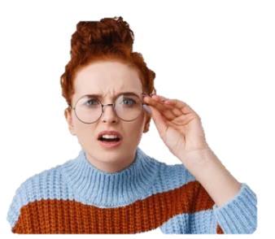
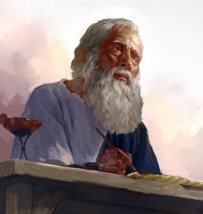
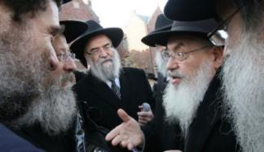
This important festival gathering for Sukkot [Tabernacles] is recorded ONLY in John’s Gospel!
Did you notice
that the detail
is very specific
as to “whose”
feast this is?
Note: Because
the synoptic
gospels left
out the details
of this festival,
do you suppose John includes this event for a very special reason?
Does that mean this is also
the timing of Yahusha’s
Festival Appointments?
“What would that reason be?

Slide 5

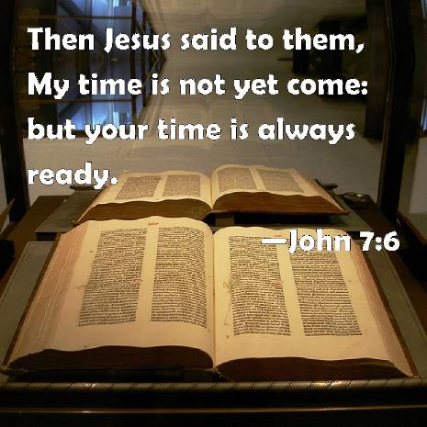
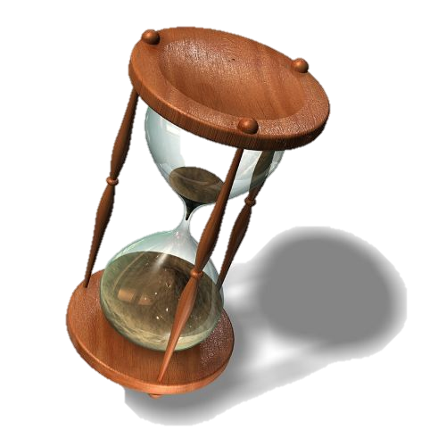
Yahusha declared
the Feast of the Jews
to His brothers as “YOUR” time?
Yahusha

Slide 6
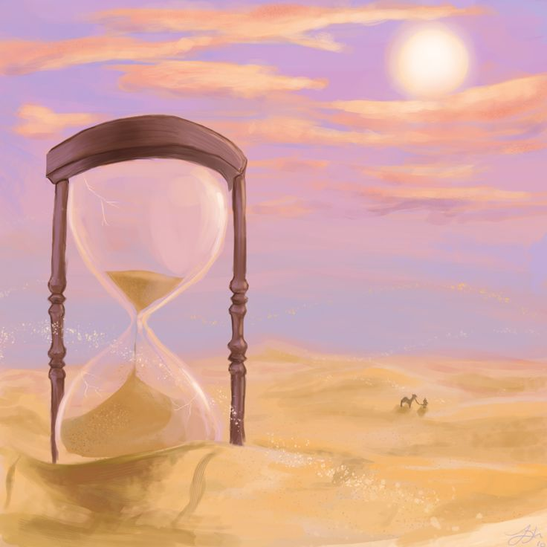
The Feast of Sukkot (Tabernacles)
(found in Exo 23:16)
is a Festival where
ALL MALES,
were required to
be in attendance
every year!
Why? This is
an Everlasting Covenant
upheld under the
Melki-Tzedek Administration!
Why on earth would Yahusha intentionally distance Himself
from a Feast that was originally commanded
by Yahuah?

Slide 7
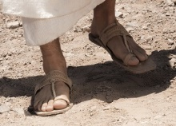
Does this mean
Yahusha can show up late?
The statute command reads like this [KJV]:
Exo 23:16-17 And the feast of harvest,
the firstfruits of thy labours, which thou hast sown in the field: and the feast of ingathering, which is in the end of the year, when thou hast gathered in thy labours out of the field. 17 Three times in the year all thy males shall appear before Yahuah your Elohim.

Slide 8
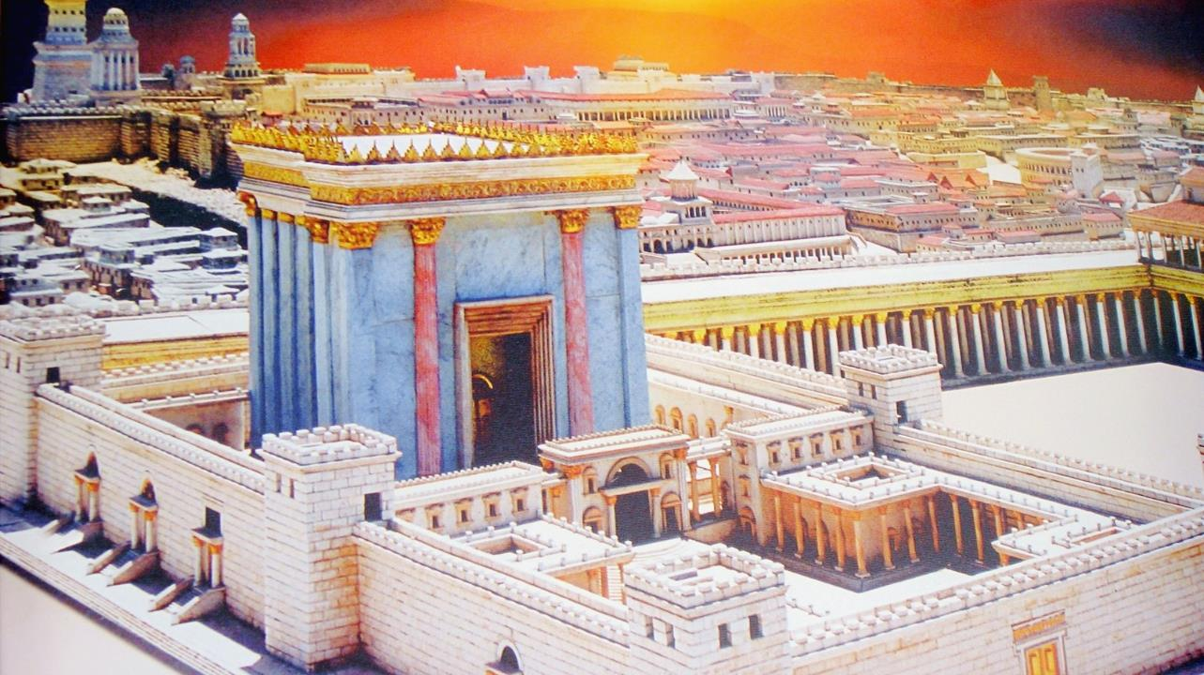
Does it sound like Yahusha is in rebellion while His brothers
are obedient to the command for all men to “go up to Jerusalem”
to attend the feast’s appointed times?

Slide 9
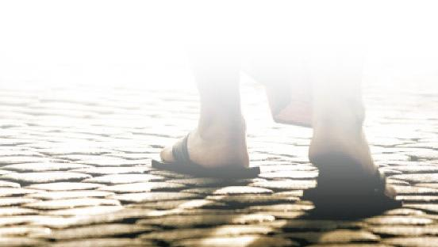

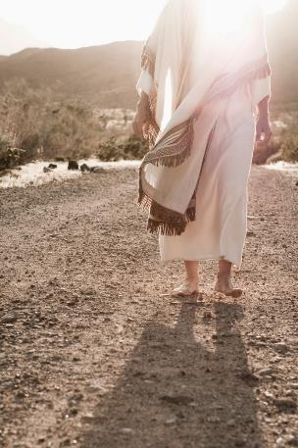
Did Yahusha Change His Mind?
“Go ye up unto this feast: I go not up yet unto this feast; for my time is not yet fully come.”
When he had said these words unto them,
he abode still in Galilee.
But when his brethren were gone up, then went he also up unto the feast, not openly, but as it were in secret.

Slide 10

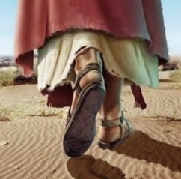
Which is more
important in John 7?
#1 The witness of
Yahusha’s words?
#2 The witness of
Yahusha’s feet?

Slide 11
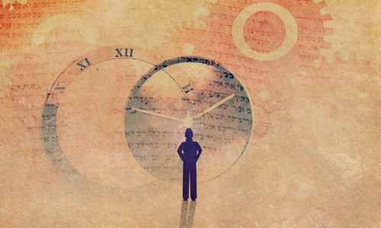
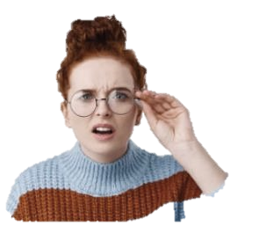
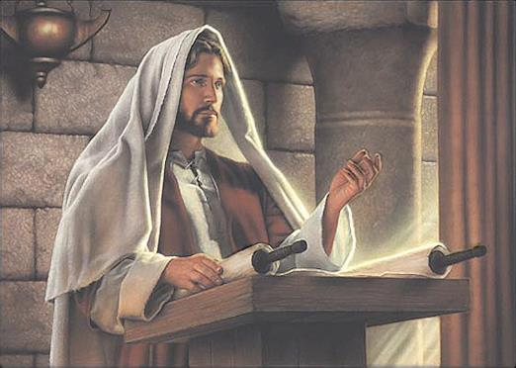


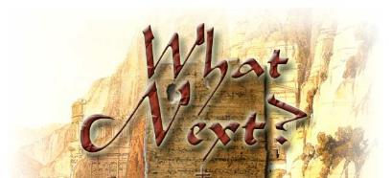
Now about
the midst of the feast
Yahusha WENT UP
into the temple,
and taught.
“… midst of
the feast”?
11

Slide 12
Have we been
MISSING OUT
on the
incredible testimony
of
Yahusha’s feet?
And now there is another question that needs to be asked …

Slide 13
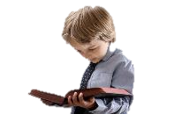

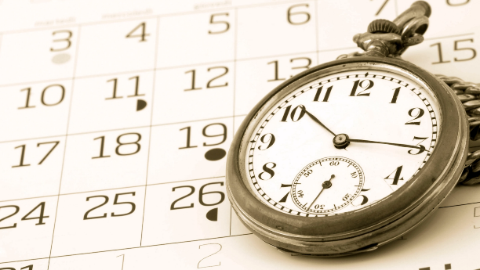
The only way that John can be so specific about the dating in chap. 7
is because the Gospels house the Lunar calendar of the unbelieving Jews and also the Torah Covenant Calendar that Yahusha observed.
The Gospels expose both the
true & false calendars so all can know exactly which “calendar” Yahusha was following.
“Yes
there
are!”
Are there really two different
calendars in John chapter 7?
Come and See what John has to share
with you.!
The End
13

Slide 14
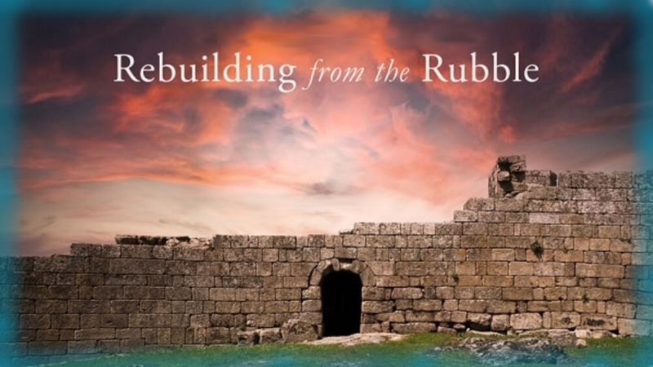

If you enjoyed this introduction today …
Please Join Us Live for Part 1!
Sign up with Covenant Calendar Club
for the Friday & Shabbat Zoom Meetings
(including live discussion)
** All studies can be
downloaded for FREE!
https://studythecalendar.com/sign-up/

Slide 15

Please send any questions to:
Timothy Astleford
questions@studythecalendar.com
Thank-you for being with us today!
Shalom!
15

